Slide 1






Mediation and Fuzzy Mediation Analysis for Multiple Covariates and Its Applications to Solar Power Data
Department of Mathematics and Statistics, Sejong University
Department of Digital Content, Sejong University
Yeon Kyung Lee¹, Jung Eun Lee¹, Sung Wook Baik² and Jin Hee Yoon ^{1*}
Nov,20,2021
1

Slide 2
Contents
1
Introduction
2
Preliminaries
- Background
- Need for our research
Simple Mediation Analysis
Fuzzy Mediation Analysis
3
Our study
4
Application to data
- Mediation Analysis for Multiple Covariates
- Fuzzy Mediation Analysis for Multiple Covariates
- Solar Power Data
2

Slide 3
1
Introduction
3

Slide 4



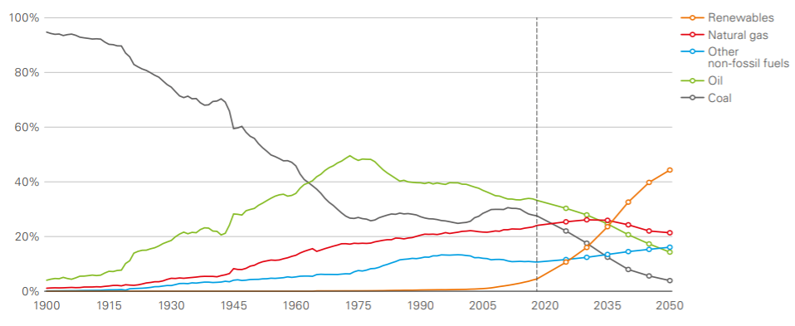
1
1
Introduction
Introduction
01
Introduction
[ Background] The importance of accurately predicting solar energy
01
BP , Energy Outlook 2020 edition
The increasing amount of renewable energy, and solar energy which accounts for a large portion of it.
Solar power generation
Advantages : free development location conditions, safe and long equipment life, infinite energy source
Disadvantages : fluctuating output depending on the position of the sun, the season, and the weather
Many studies have been conducted on solar power prediction models
http://energytransitionkorea.org/sites/default/files/2020-09/bp-energy-outlook-2020.pdf
4

Slide 5

1
Introduction
01
Introduction
Prior research and the need for our research
01
In Solar Prediction models,
lack of research to understand the relationships with variables
Statistic model : ARMA, ARIMA
Machine learning methods : SVM, ANN, LSTM
Our study will prevent excessive interpretation of the results.
02
In mediation models,
lack of model for multiple independent variables or covariates with mediators
various mediation models for multiple mediators, moderators or confounding variables have been proposed.
But, unfortunately, a mediation model for multiple independent variable or covariates has not been dealt with.
03
About data,
Observations require fuzzification
Observations such as actual weather information, solar radiation, and solar energy generation require fuzzification
because they are observed with ambiguous values rather than crisp values
5

Slide 6
2
Preliminaries
6

Slide 7
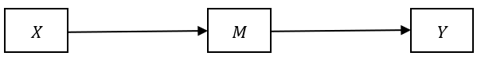
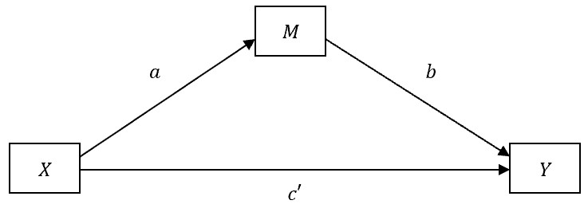
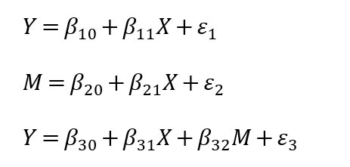
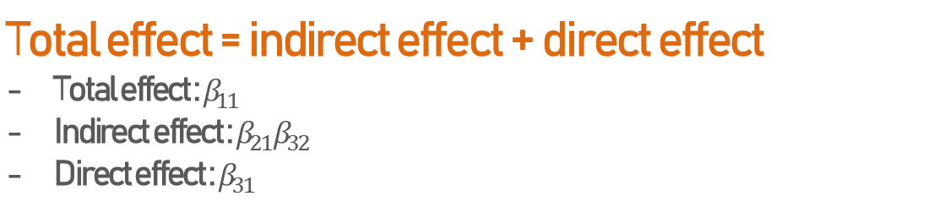
2
2
Preliminaries
Preliminaries
02
Simple Mediation Analysis and Fuzzy Mediation Analysis
1. Simple Mediation Analysis
01
Simple Mediation Model by Baron and Kenny (1986)
Total effect = indirect effect + direct effect
Total effect : $β_{11}$
Indirect effect : $β_{21}β_{32}$
Direct effect : $β_{31}$
7

Slide 8
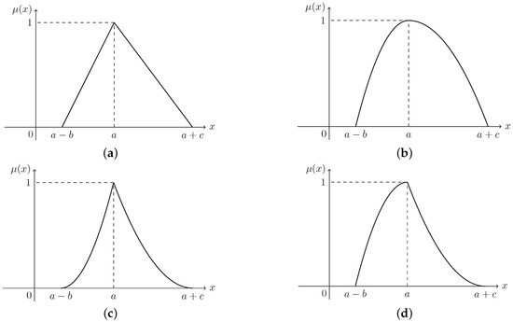
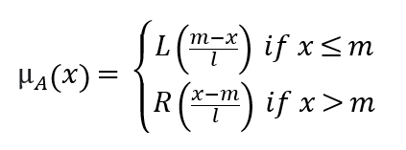
2
2
Preliminaries
Preliminaries
02
Simple Mediation Analysis and Fuzzy Mediation Analysis
2. Simple Fuzzy Mediation Analysis
01
Fuzzy numbers by Zadeh (1965)
<LR-fuzzy number>
Generalization of a real number by representing a continuous set of possible values between 0 and 1, not one value
L : left shape function
R : right shape function
m : mode of the fuzzy number
l : width of the left
r : width of the right
Zhou, J.; Huang, C.; Zhao, M.; Li, H. Entropy and Semi-Entropies of LR Fuzzy Numbers’ Linear Function with Applications to Fuzzy Programming. Entropy 2019, 21, 697.
8

Slide 9
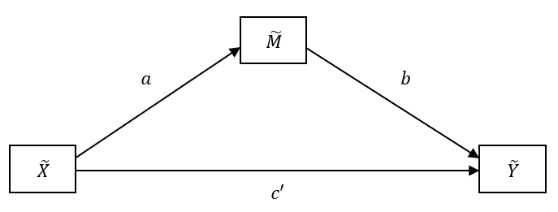
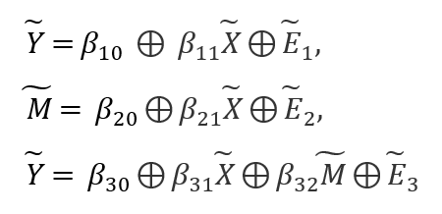
2
Preliminaries
02
Simple Mediation Analysis and Fuzzy Mediation Analysis
2. Simple Fuzzy Mediation Analysis
02
Simple Fuzzy Mediation Model by Yoon (2020)
Total effect = indirect effect + direct effect
Total effect : $β_{11}$
Indirect effect : $β_{21}β_{32}$
Direct effect : $β_{31}$
9

Slide 10
3
Our study
10

Slide 11
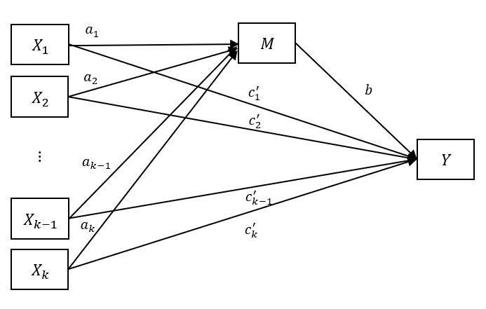
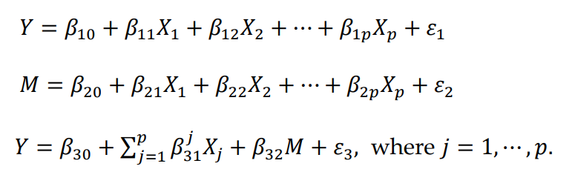
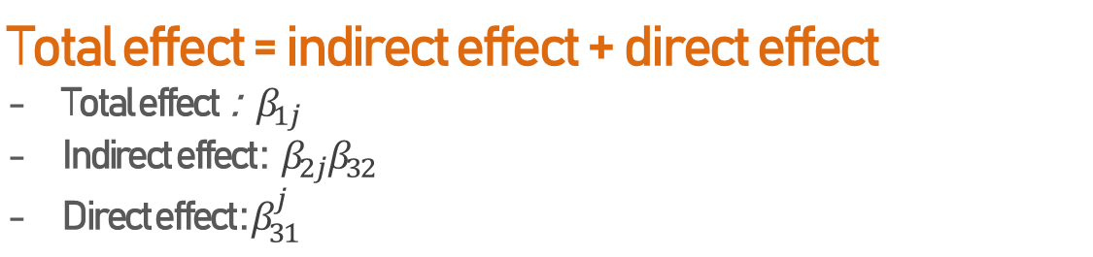
3
3
Our study
Our study
03
Mediation Analysis for Multiple Covariates
1. Mediation Analysis for Multiple Covariates with one mediator
01
One mediator
Total effect = indirect effect + direct effect
Total effect :${ β}_{1j}$
Indirect effect : ${ β}_{2j}β_{32}$
Direct effect : $β_{31}^{j}$
11

Slide 12
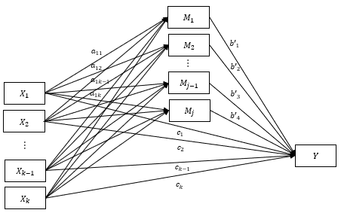
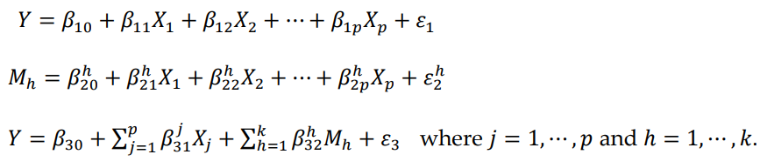
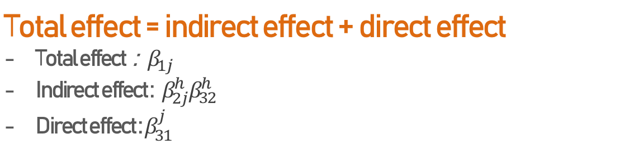
3
3
Our study
Our study
03
Mediation Analysis for Multiple Covariates
2. Mediation Analysis for Multiple Covariates with multiple mediators
02
Multiple mediators
Total effect = indirect effect + direct effect
Total effect :${ β}_{1j}$
Indirect effect : ${ β}_{2j}^{h}β_{32}^{h}$
Direct effect : $β_{31}^{j}$
12

Slide 13
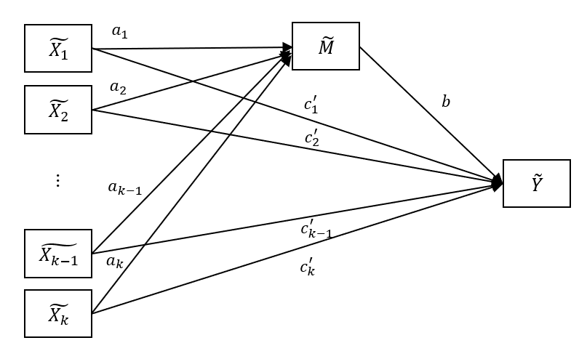
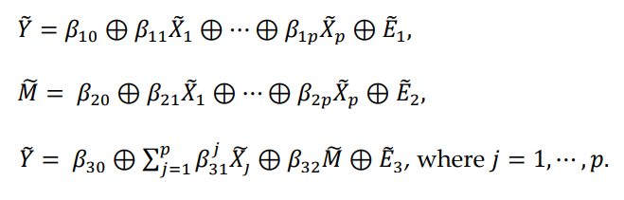
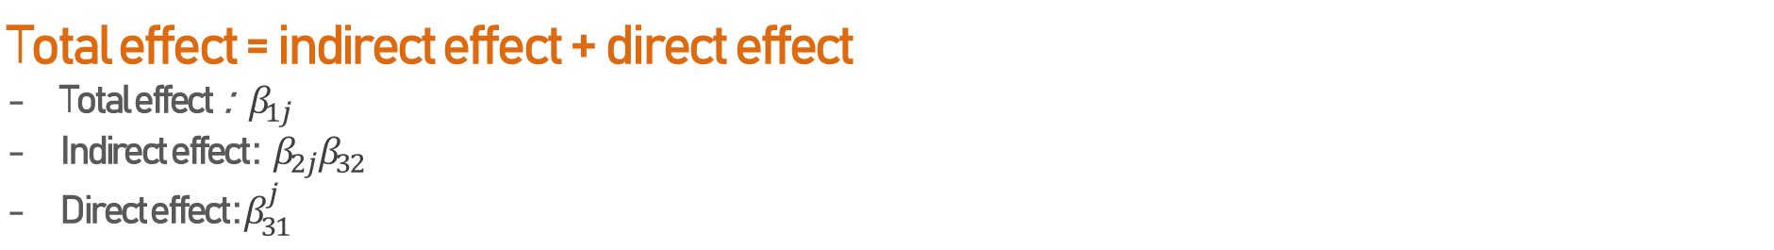
3
3
Our study
Our study
04
Fuzzy Mediation Analysis for Multiple Covariates
1. Fuzzy Mediation Analysis for Multiple Covariates with one mediator
01
One mediator
Total effect = indirect effect + direct effect
Total effect :${ β}_{1j}$
Indirect effect : ${ β}_{2j}β_{32}$
Direct effect : $β_{31}^{j}$
13

Slide 14
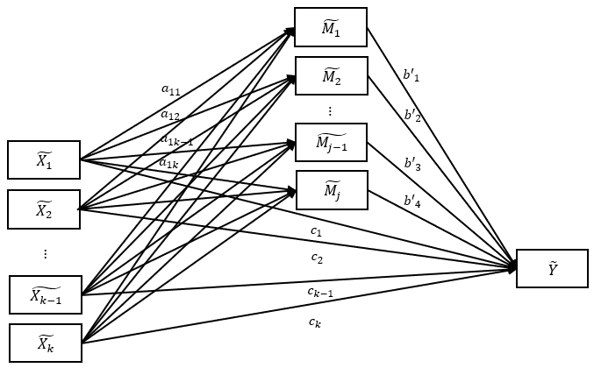
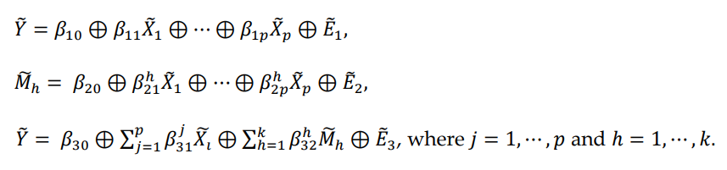
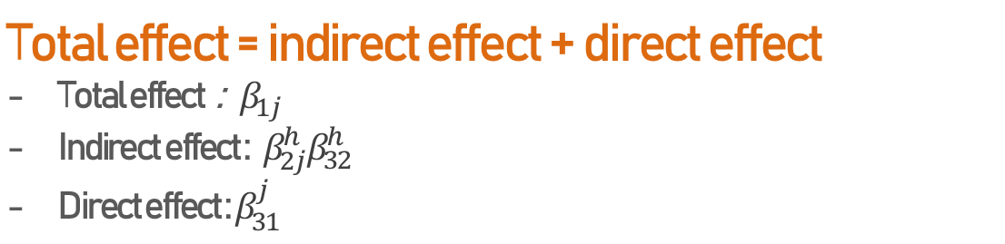
3
3
Our study
Our study
04
Fuzzy Mediation Analysis for Multiple Covariates
2. Fuzzy Mediation Analysis for Multiple Covariates with multiple mediators
02
Multiple mediators
Total effect = indirect effect + direct effect
Total effect :${ β}_{1j}$
Indirect effect : ${ β}_{2j}^{h}β_{32}^{h}$
Direct effect : $β_{31}^{j}$
14

Slide 15
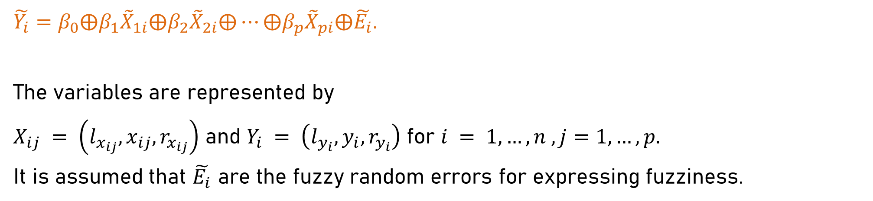
3
3
Our study
Our study
04
Fuzzy Mediation Analysis for Multiple Covariates
3. Estimation for Fuzzy Mediation Analysis for Multiple Covariates with mediators
03
$\tilde{Y_{i}}=β_{0}⨁β_{1}{\tilde{X}}_{1i}⨁β_{2}{\tilde{X}}_{2i}⨁⋯⨁β_{p}{\tilde{X}}_{pi}⨁\tilde{E_{i}}$.
The variables are represented by
$X_{ij} = \left(l_{x_{ij}}, x_{ij},r_{x_{ij}}\right)$ and $Y_{i} = \left(l_{y_{i}}, y_{i},r_{y_{i}}\right)$ for $i = 1, …, n , j=1,…,p.$
It is assumed that $\tilde{E_{i}}$ are the fuzzy random errors for expressing fuzziness.
The objective function can be obtained based on the LSE, and here the LSE can be expressed as follows
J. H. Yoon, Fuzzy mediation analysis, Int. J. Fuzzy Syst. vol. 22, no. 1, pp.338-349 (2020)
J. H. Yoon, Fuzzy Moderation and Moderated-Mediation Analysis. Int. J. Fuzzy Syst. vol 22, no. 1, pp. 338-349 (2020)
15

Slide 16
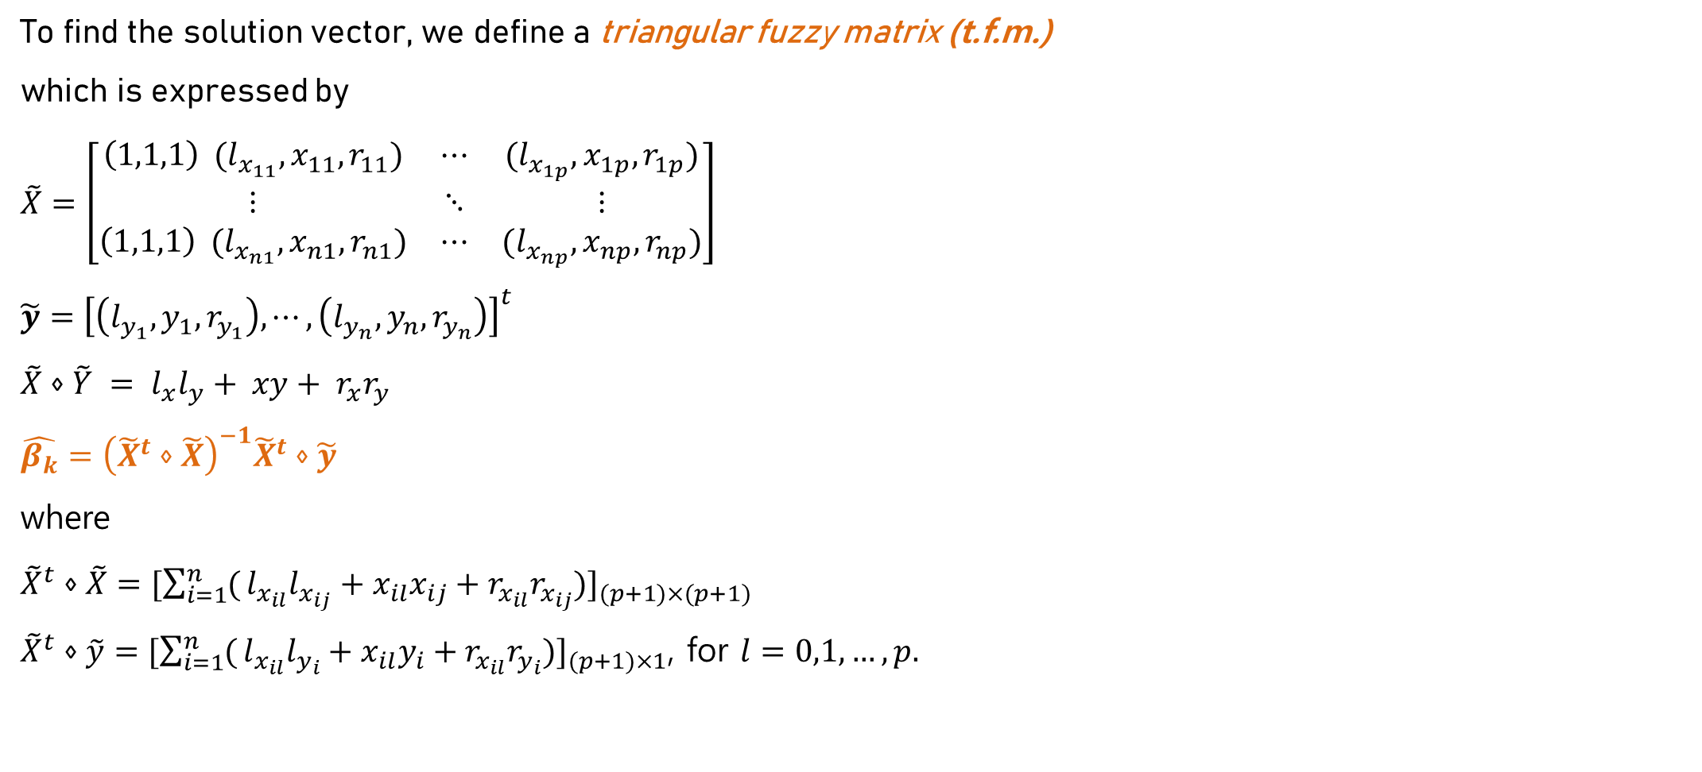
3
Our study
04
Fuzzy Mediation Analysis for Multiple Covariates
3. Estimation for Fuzzy Mediation Analysis for Multiple Covariates with mediators
03
To find the solution vector, we define a triangular fuzzy matrix (t.f.m.)
which is expressed by
$\tilde{X}=\left[\begin{matrix}\left(1,1,1\right) (l_{x_{11}},x_{11},r_{11}) & ⋯ & (l_{x_{1p}},x_{1p},r_{1p}) \\ ⋮ & ⋱ & ⋮ \\ \left(1,1,1\right) (l_{x_{n1}},x_{n1},r_{n1}) & ⋯ & (l_{x_{np}},x_{np},r_{np})\end{matrix}\right]$
$\tilde{y}={\left[\left(l_{y_{1}},y_{1},r_{y_{1}}\right), ⋯,\left(l_{y_{n}},y_{n},r_{y_{n}}\right)\right]}^{t}$
$\tilde{X}⋄\tilde{Y} = l_{x}l_{y}+ xy+ r_{x}r_{y}$
$\hat{β_{k}}={\left({\tilde{X}}^{t}⋄\tilde{X}\right)}^{−1}{\tilde{X}}^{t}⋄\tilde{y}$
where
${\tilde{X}}^{t}⋄\tilde{X}={[\sum_{i=1}^{n}{(}l_{x_{il}}l_{x_{ij}}+x_{il}x_{ij}+r_{x_{il}}r_{x_{ij}})]}_{(p+1)×(p+1)}$
${\tilde{X}}^{t}⋄\tilde{y}={[\sum_{i=1}^{n}{(}l_{x_{il}}l_{y_{i}}+x_{il}y_{i}+r_{x_{il}}r_{y_{i}})]}_{(p+1)×1}$, for $l=0,1,…,p.$
16

Slide 17
4
Application to data
17

Slide 18
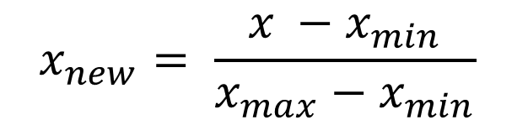
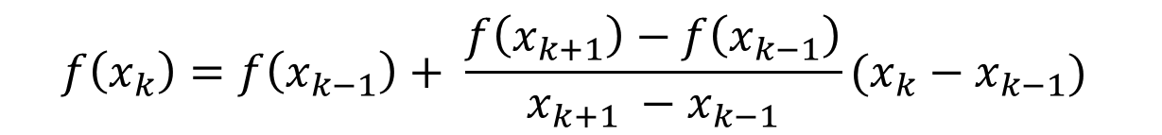
4
4
Application to data
Application to data
05
Fuzzy mediation Analysis with Multiple Covariates for Solar Power Data
Data
●
This data was collected every hour
from 1 a.m. on January 1, 2015 to 11 p.m. on December 31, 2017
at a solar energy facility in Dangjin, Korea.
1.
Processing missing values => Linear interpolation
$$f\left(x_{k}\right)=f\left(x_{k−1}\right)+ \frac{f\left(x_{k+1}\right)−f\left(x_{k−1}\right)}{x_{k+1} −x_{k−1}}(x_{k}−x_{k−1})$$
2.
Normalization
$$x_{new}= \frac{x −x_{min}}{x_{max}−x_{min}}$$
18

Slide 19
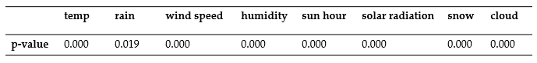
4
4
Application to data
Application to data
05
Fuzzy mediation Analysis with Multiple Covariates for Solar Power Data
Data
●
This data was collected every hour
from 1 a.m. on January 1, 2015 to 11 p.m. on December 31, 2017
at a solar energy facility in Dangjin, Korea.
3.
Significant variables
(after regression analysis)
4.
fuzzification
Date | Before fuzzification | m, l, r | After fuzzification
2015-01-01-1:00AM | -4.4 | M : -4.4, l, r : |-4.6-(-4.4)|/2 = 0.1 | (-4.5,-4.4,-4.3)
2015-01-01-2:00AM | -4.6 | M : -4.6, l, r : |-4.7-(-4.6)|/2 = 0.05 | (-4.65, -4.6, -4.55)
2015-01-01-3:00AM | -4.7 | M : -4.7, l, r : |-5-(-4.7)|/2 = 0.15 | (-4.85, -4.7, -4.55)
For the last data, we use diff before that
19

Slide 20
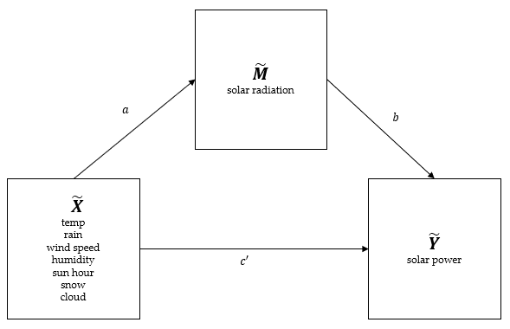
4
4
Application to data
Application to data
05
Fuzzy mediation Analysis with Multiple Covariates for Solar Power Data
Research hypothesis
01
Solar radiation mediates weather conditions with solar power
independent variables : weather data
mediator : radiation
dependent variable : solar power
02
Fuzzy Mediation Analysis for Multiple Covariates
will have more significant result than Mediation.
- H. Lee. Use of the Moving Average of the Current Weather Data for the Solar Power Generation Amount Prediction. KMMS. vol. 19, no. 8, pp. 1530-1537 (2016)
-. J. Jeong, Y. Tae. Comparison Analysis for Characteristic of Short-Term Power generation Forecasting models for Building Integrated photovoltaics. AIK. vol. 36, no.2, pp. 665-666 (2016)
- K. Lee, W. Kim. Forecasting of 24_hours Ahead Photovoltaic Power Output Using Support Vector Regression. JKIIT. vol. 14, no. 3, pp. 175-183 (2016)
- J. Jeong, Y. Chae. Improvement for Forecasting of Photovoltaic Power Output using Real Time Weather Data based on Machine Learning. KSLES. vol. 25, no. 1, pp. 119-125 (2018)
20

Slide 21
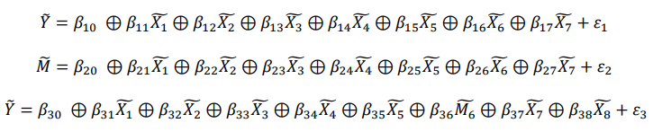
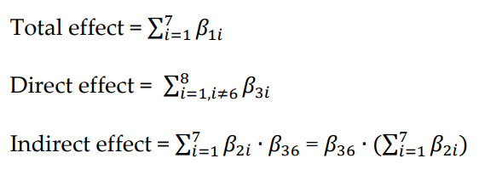
4
4
Application to data
Application to data
05
Fuzzy mediation Analysis with Multiple Covariates for Solar Power Data
Model
<Fuzzy Mediation Analysis for Multiple Covariates with one mediator>
Total effect = indirect effect + direct effect
21

Slide 22
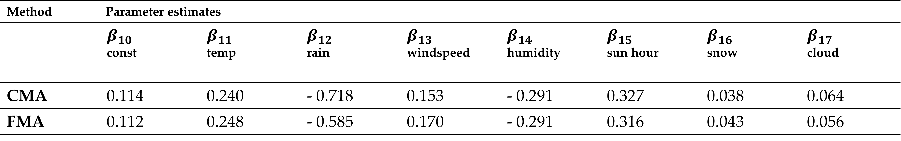
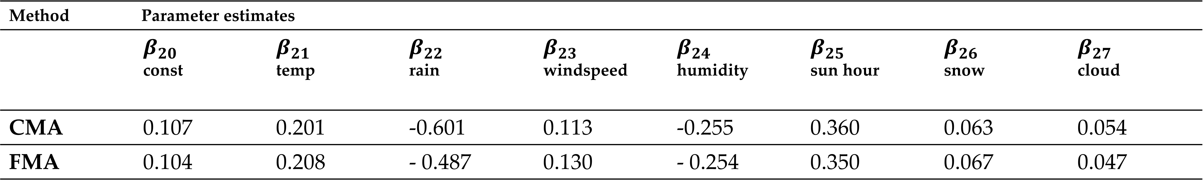
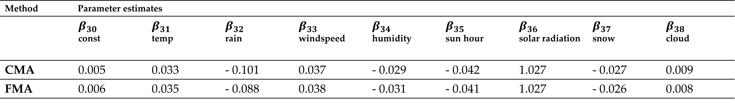
4
4
Application to data
Application to data
05
Fuzzy mediation Analysis with Multiple Covariates for Solar Power Data
Parameters estimates
CMA: classic mediation analysis
FMA: fuzzy mediation analysis
(a) Parameters estimates between weather conditions and solar power
(b) Parameters estimates between weather conditions and solar radiation
(c) Parameters estimates between weather conditions + solar radiation and solar power
22

Slide 23
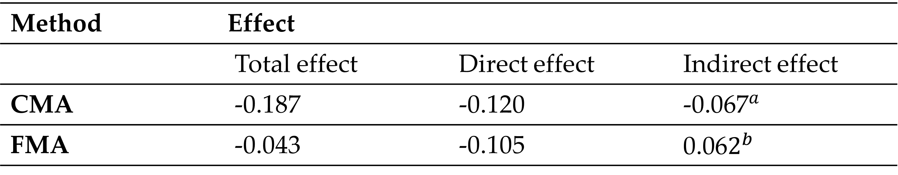
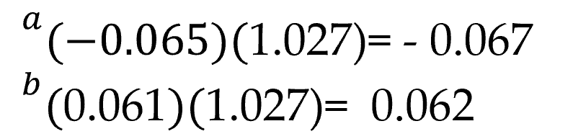
4
Application to data
05
Fuzzy mediation Analysis with Multiple Covariates for Solar Power Data
Effects of the solar radiation
FMA considers the spread of data rather than CMA using summarized data
FMA effect will be more reliable than CMA.
23

Slide 24

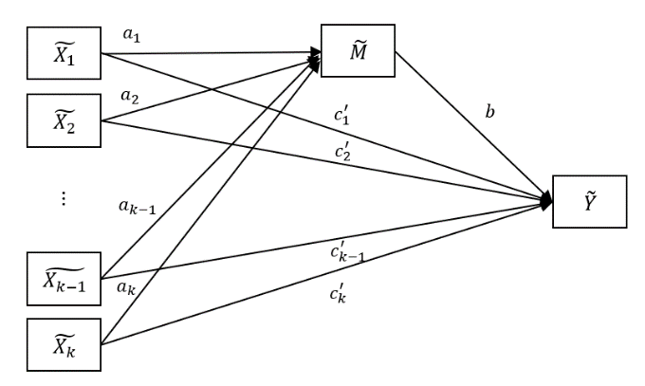
06
Conclusions
01
Need for our research
In Solar Prediction models,
lack of research to understand the relationships with variables
1.Solar radiation will mediate weather conditions and solar power.
2.Fuzzing the data will have more meaningful results than using crisp data
02
Research hypothesis
CMA
FMA
03
Model
04
Result
FMA effect will be more reliable than CMA.
05
Follow-up study
- Statistical Inferences about direct effect and indirect effect
- This theory is to be extended to
other various mediation, moderation, mediation-moderation analysis
24

Slide 25
연구조사방법론 연구과제발표
Thank you
25

